Slide 1
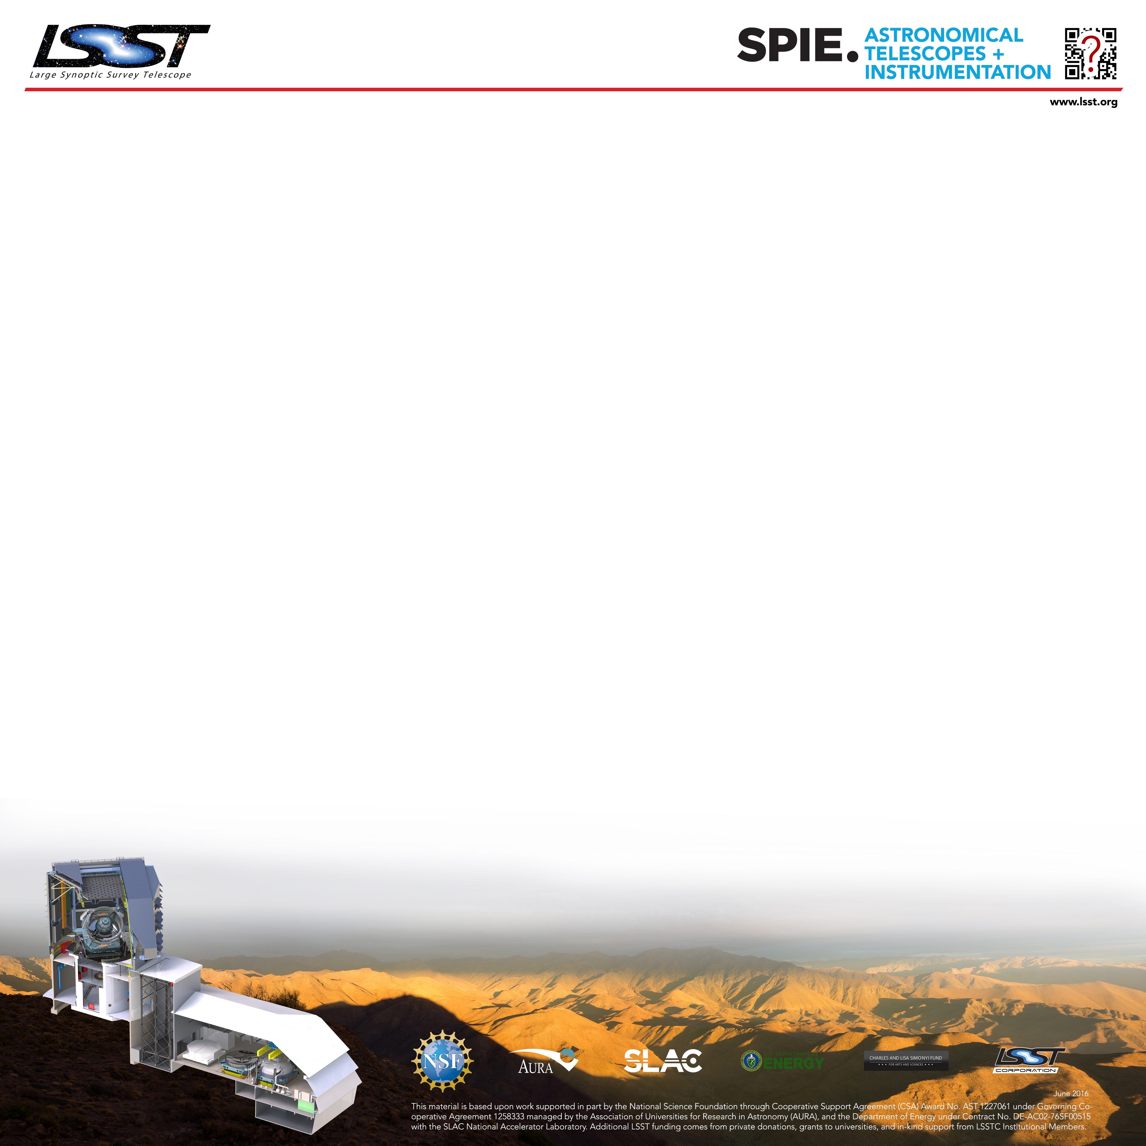
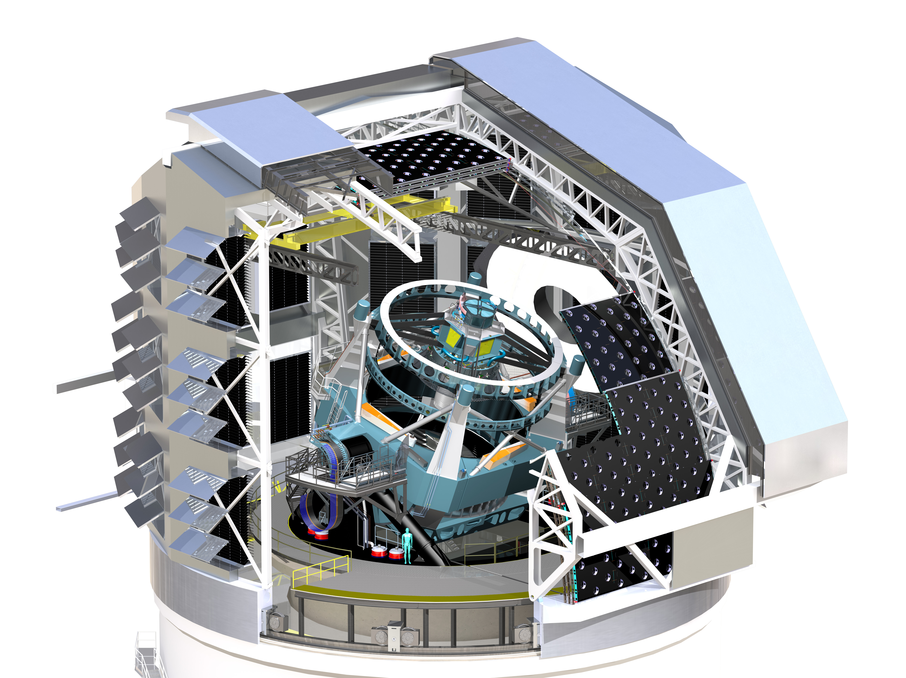
Simulating the LSST OCS for Conducting Survey Simulations Using the LSST Scheduler Michael A. Reuterª, Kem H. Cook^{b}, Francisco Delgadoª, Catherine E. Petryª, Stephen T. Ridgway^{c}
ªLarge Synoptic Survey Telescope ^{b}Cook Astronomical Consulting ^{c}National Optical Astronomy Observatory
INTRODUCTION
DEVELOPMENT
USE CASES
The Large Synoptic Survey Telescope (LSST) requires an automated Scheduler to ensure progress in time and sky coverage towards a dataset which will meet the science goals of the project¹. The Operations Simulator (OpSim3)² was created to prototype the Scheduler, and currently the Scheduler³ is being developed as a separate codebase to interface with the Observatory Control System (OCS)^{4,5} for operations. A new simulator is under concurrent development to adjust to this new architecture, and it requires a package simulating enough of the OCS to allow execution of realistic schedules. This new package is called the Simulated OCS (SOCS), and the new SOCS/Scheduler pair is collectively called OpSim4.
Scheduler
While the main use case of OpSim4 is pre-operational studies of
scheduling algorithms and science proposals, the separated
SOCS/Scheduler allows for other interesting use cases:
SOCS
Simulation
Kernel
Control
SOCS
Sequencer
History
OCS
EFD
Configuration and visit
history for SOCS taken
from Engineering Facilities DB (EFD) to create clone of operational Scheduler
Telemetry
Cmd
Visits
Image Quality
Sched
Telem
Targets
Visits
Operations
Scheduler
communications middleware
SOCS
Expected
Targets
SOCS
Survey Database
Run forward for
schedule time window
SOCS
Observatory
Model
SOCS
Quality
Simulator
SOCS
Environment
Model
Scheduler
Figure 2: Diagram showing the communication pathways between SOCS and the Scheduler systems.
Figure 3: Using clone of operational Scheduler to forecast the proposed target fields for a given time window (e.g. 2 hours).
The current development plan has version 1.0 of OpSim4 slated for delivery in the fall of 2016. It will encompass all of the functionality of OpSim3 plus some enhancements not available in OpSim3. OpSim4 will run with two separate instances of the Observatory model, one in SOCS (the “real” one) and the other in the Scheduler (the model). OpSim4 will also include the latest environmental information that has been gathered from the LSST site.
OCS
EFD
Configuration and visit
history for SOCS taken
from Engineering Facilities DB (EFD) to create clone of operational Scheduler
Operations Simulator
Scheduler
Operations Simulator
Simulated OCS (SOCS)
Scheduler
DDS
Operations
Scheduler
Alternate
Configuration
SOCS
Alternate
Survey
Figure 1a: Operational bounding box for OpSim version 3 (OpSim3). Scheduler prototype is embedded within simulator.
Figure 1b: Operational bounding box for OpSim version 4 (OpSim4). Scheduler is separated from simulator and communicates across common API (DDS*)
Add/change science proposals and configuration to produce “new” survey
Scheduler
SOCS software development uses the LSST Agile process⁶ and follows the basic tenants of Test Driven Design (TDD)⁷. Each release cycle is tightly coupled with the LSST Scheduler development cycle. Integration of new features occurs continuously throughout the release cycle.
Figure 4: Using clone of operational Scheduler to explore new or varied science proposals and instrument configurations.
REFERENCES
*DDS is the Data Distribution Service. See reference [4].
Kahn, S., Proc SPIE 9906 in press (2016)
Cook, K. et. al., Proc SPIE 9911 in press (2016)
Delgado, F., Proc SPIE 9910 in press (2016)
Daly, P. and Schumacher, H., Proc SPIE 9913 in press (2016)
Mills, D. et. al., Proc SPIE 9906 in press (2016)
Kantor, J. et. Al., Proc SPIE 9911 in press (2016)
Beck, K., Test Driven Development: By Example (2002)

